Slide 1

I/O Streams
Notes:
Just into on why we’re here today and what’s the point of having this presentation. Brifely touch the topic of presenters: SZ, OZ, IL, and KK.
In the end: passing the floot to Sviatlana.

Slide 2


I/O Streams
100101011101
I/O Stream represents an input source or an output destination. It can be disk files, devices, other programs, memory arrays.
Streams support different kinds of data, including simple bytes, primitive data types, localized characters, and objects.
All streams present the same simple model to programs – a stream is a sequence of data.
Input Stream
Data Source
Program
100101011101
Output Stream
Program
Data Source

Slide 3
I/O Streams
Some streams simply pass on data:
Hello World
Stream
Hello World
Other manipulate and transform the data:
Hello World
Stream
<greeting.zip>

Slide 4
I/O Types
Streams
Byte Stream
Character Stream

Slide 5
Byte Streams
Byte streams are used to perform input and output of 8-bit bytes. All byte stream classes are descended from InputStream and OutputStream.
All other stream types are built on byte streams.
ByteStream spends most of its time in a loop that reads the input stream and writes the output stream, one byte at a time.
Method read() returns –1 when the end is reached.
M
J
C
S
c
h
o
o
l
Read to variable
c
Cycle
Write to destination
M
J
C
S
c

Slide 6
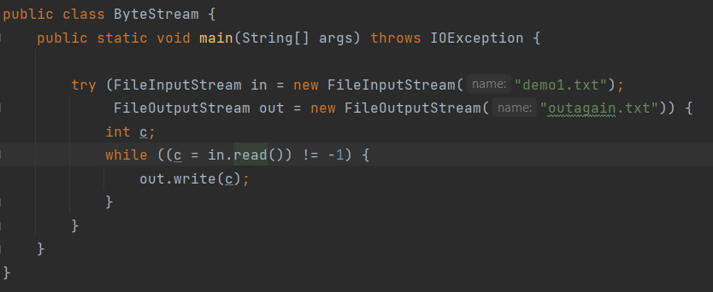
Byte Streams
NB: Closing a Stream is important, so use try-with-resources when working with Streams.

Slide 7
Character Streams
Program
Char stream
Byte stream
All character stream classes are descended from Reader and Writer.
As with byte streams, there are character stream classes that specialize in file I/O: FileReader and FileWriter.
Character streams are often "wrappers" for byte streams.
Read next char
Read bytes
Next bytes
Convert bytes to char
Next character

Slide 8
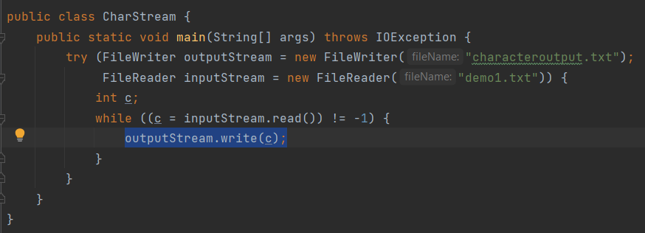
Character Streams

Slide 9
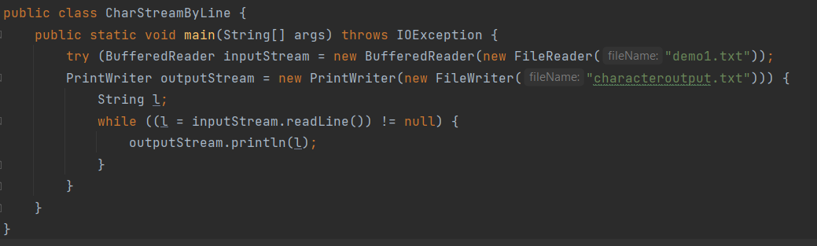
Character Streams
Character I/O usually occurs in bigger units than single characters. One common unit is the line.
Invoking readLine returns a line of text with the line. OutputStream propagates each line using println(), which appends the line terminator for the current operating system.

Slide 10
Using Buffers
Buffered I/O streams – can be used to reduce overhead of read operations. Input streams return data from a memory area, “real” input API is called only when the buffer is empty. Similarly, output streams write data to a buffer, and the native output API is called only when the buffer is full.
A program can convert an unbuffered stream into a buffered stream using the wrapping:
inputStream = new BufferedReader(new FileReader("demo1.txt")); outputStream = new BufferedWriter(new FileWriter("characteroutput.txt"));
Buffered stream classes:
BufferedInputStream and BufferedOutputStream – for byte streams
BufferedReader and BufferedWriter – for character streams.

Slide 11
I/O Streams
BufferedReader
InputStreamReader
Streams can be chained for the best effect.
For example, FileInputStream can be wrapped by InputStreamReader, and then by BufferedReader.
FileInputStream

Slide 12
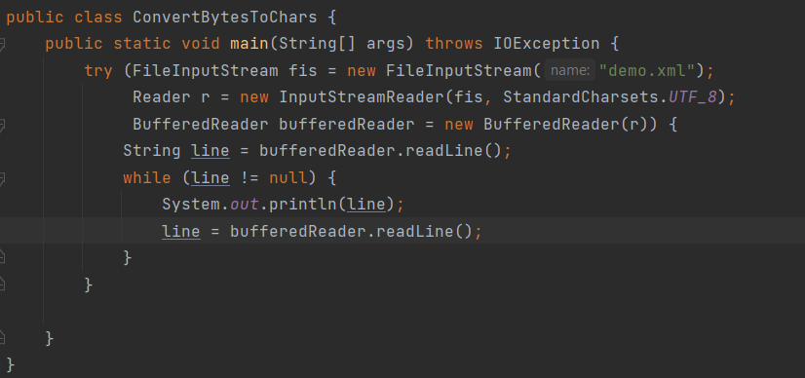
Stream combination

Slide 13
Working with File System
A file system stores files in such a way that they can be easily retrieved. Most file systems in use today store the files in a tree structure. At the top of the tree are root nodes. Under the root node, there are files and directories (folders in Windows). Each directory can contain files and subdirectories.
A file is identified by its path through the file system beginning from the root node:
absolute path – always contains the root element and the complete directory list required to locate the file
relative path – needs to be combined with another path to access a file.
C:\
Programs
User
Admin
IntellijIdea
Postgres

Slide 14
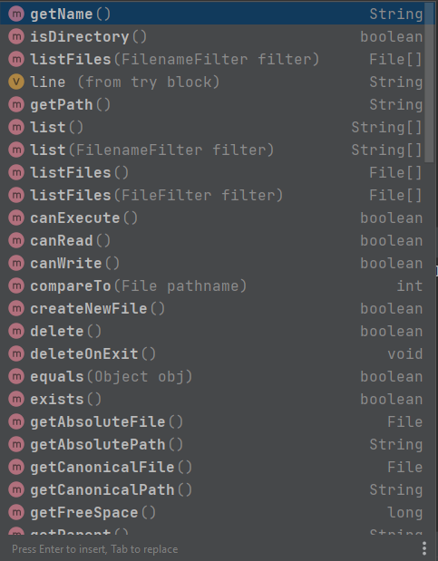
File class
File class – Java’s representation of a file or directory pathname.
Because file and directory names have different formats on different platforms, a simple string is not adequate to name them.

Slide 15
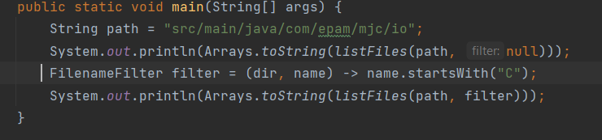
Filename filter
FilenameFilter is an interface in Java that is used to filter file names, such as those returned from a call to a File object's listFiles() method.

Slide 16
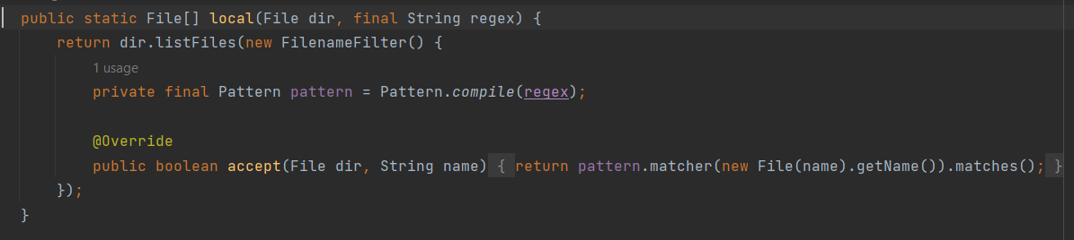
Filename filter
And you can implement it with anonymous class:

Slide 17
NIO
The java.nio package was introduced in Java 1.4 and updated in Java 1.7 (NIO.2) with enhanced file operations. It provides:
Buffer – to read chunks of data at a time
CharsetDecoder – for mapping raw bytes to/from readable characters
Channel – for communicating with the outside world
Selector – to enable multiplexing on a SelectableChannel and provide access to any Channels that are ready for I/O
Non-blocking mode – to read whatever is ready.
Files and Paths classes with useful static methods.

Slide 18
NIO
Buffer – space in memory. It can reside in the heap or off-heap, which is useful for large buffers.
Channel – can connect to file or socket and can write from buffer or read to the buffer. A channel only knows bytes buffers.
DataSource
(file, socket, etc)
Buffer

Slide 19
NIO Channel
The Channel is implemented by several classes.
FileChannel - allows for multiple reads and writes
DatagramChannel - to access to socket. It supports multicast since it is UDP and it supports multiple, non-concurrent reads and writes.
SocketChannel and ServerSocketChannel – to access to a TCP socket. It supports asynchronous operations and multiple, non-concurrent reads and writes.

Slide 20
NIO Buffer
Java Process memory
Buffer – in-memory structure backed by an array of bytes. The size of a buffer can be as large as 2GB.
It is usually stored in the heap, handled by the garbage collector.
But it can also be stored in the off-heap, thus not impacting the garbage collector. This is very useful for very large buffers.
Heap
(managed by GC)
Off-heap
(not managed by GC)

Slide 21
NIO Buffer
Buffer – Write mode
Buffer – Read mode
A buffer properties:
capacity – size of the backing array.
current position – can be seen as cursor. All the read and the write operations are made to or from the current position.
limit – last position in memory seen by this buffer.
Position
Position
Limit
Limit
Capacity
Capacity

Slide 22
Further readings
Oracle tutorials
Decorator Pattern
"Thinking in Java" by Bruce Eckel

